Slide 1
CSE 416
Section 3 - Midterm Review

Slide 2
Reminders!
Learning Reflection 3 due Monday April 22 at 11:59
Midterm to be out Monday April 22 at 8:30 AM and due April 24 at 11:59 PM
Released on Gradescope
Instructions will be posted on Ed

Slide 3
Midterm Review!

Slide 4
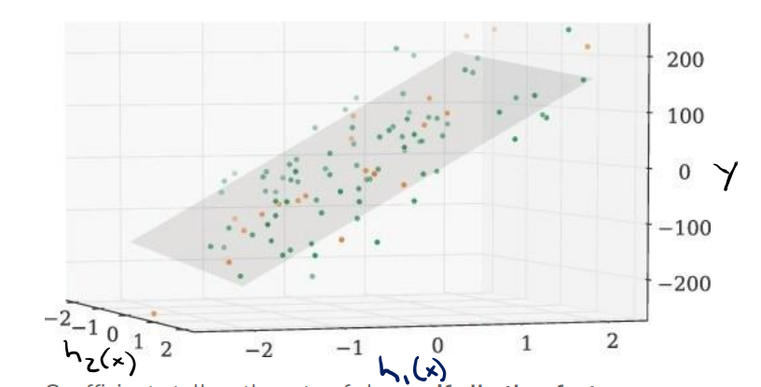
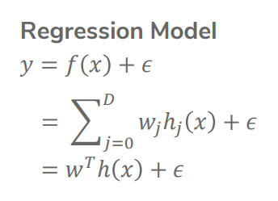
Linear Regression Model
Assumption: We can fit the input h(X) and output y with a hyperplane
Ie. The relationship between h(X) and y is linear
Notes:
Q: Define a loss, and use GD to find w that minimizes loss

Slide 5
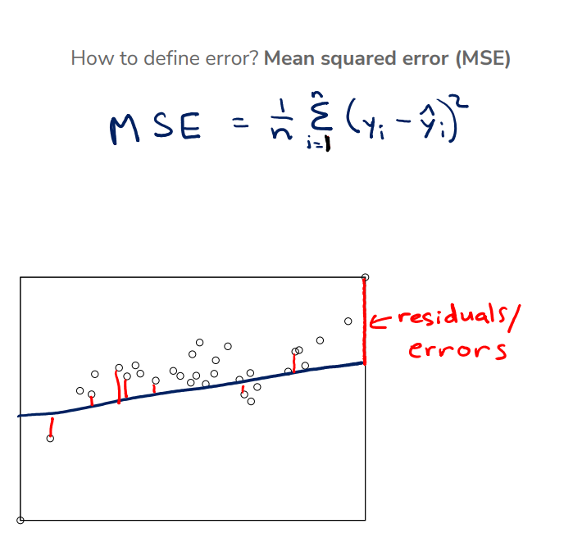
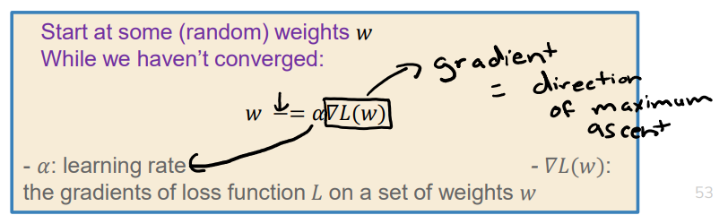
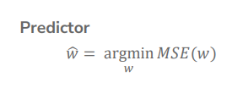
Model Training: Learn parameters w
Define a loss function: MSE 2. Use Gradient Descent to minimize loss
Goal: Find w_hat
Notes:
MSE: for each data point, calculate the distance^2 between the true y and predicted y, and average all distances. (average residual^2)
GD: start at some random w, and update w (drawing a bowl-shape graph may help)
Q: 1. validation set 2. Cross-validation
Learning rate can affect model training. Emphasize that we cannot use test data to choose learning rate!

Slide 6
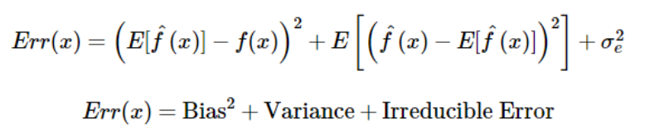
Bias-Variance Tradeoff
Overfitting and underfitting are the result of two types of error: bias and variance
Bias:
difference between true function f(x) and “average” predictor
Variance:
variability of model prediction for a given data point
Simple models: High bias + Low variance
Complex models: Low bias + High variance

Slide 7
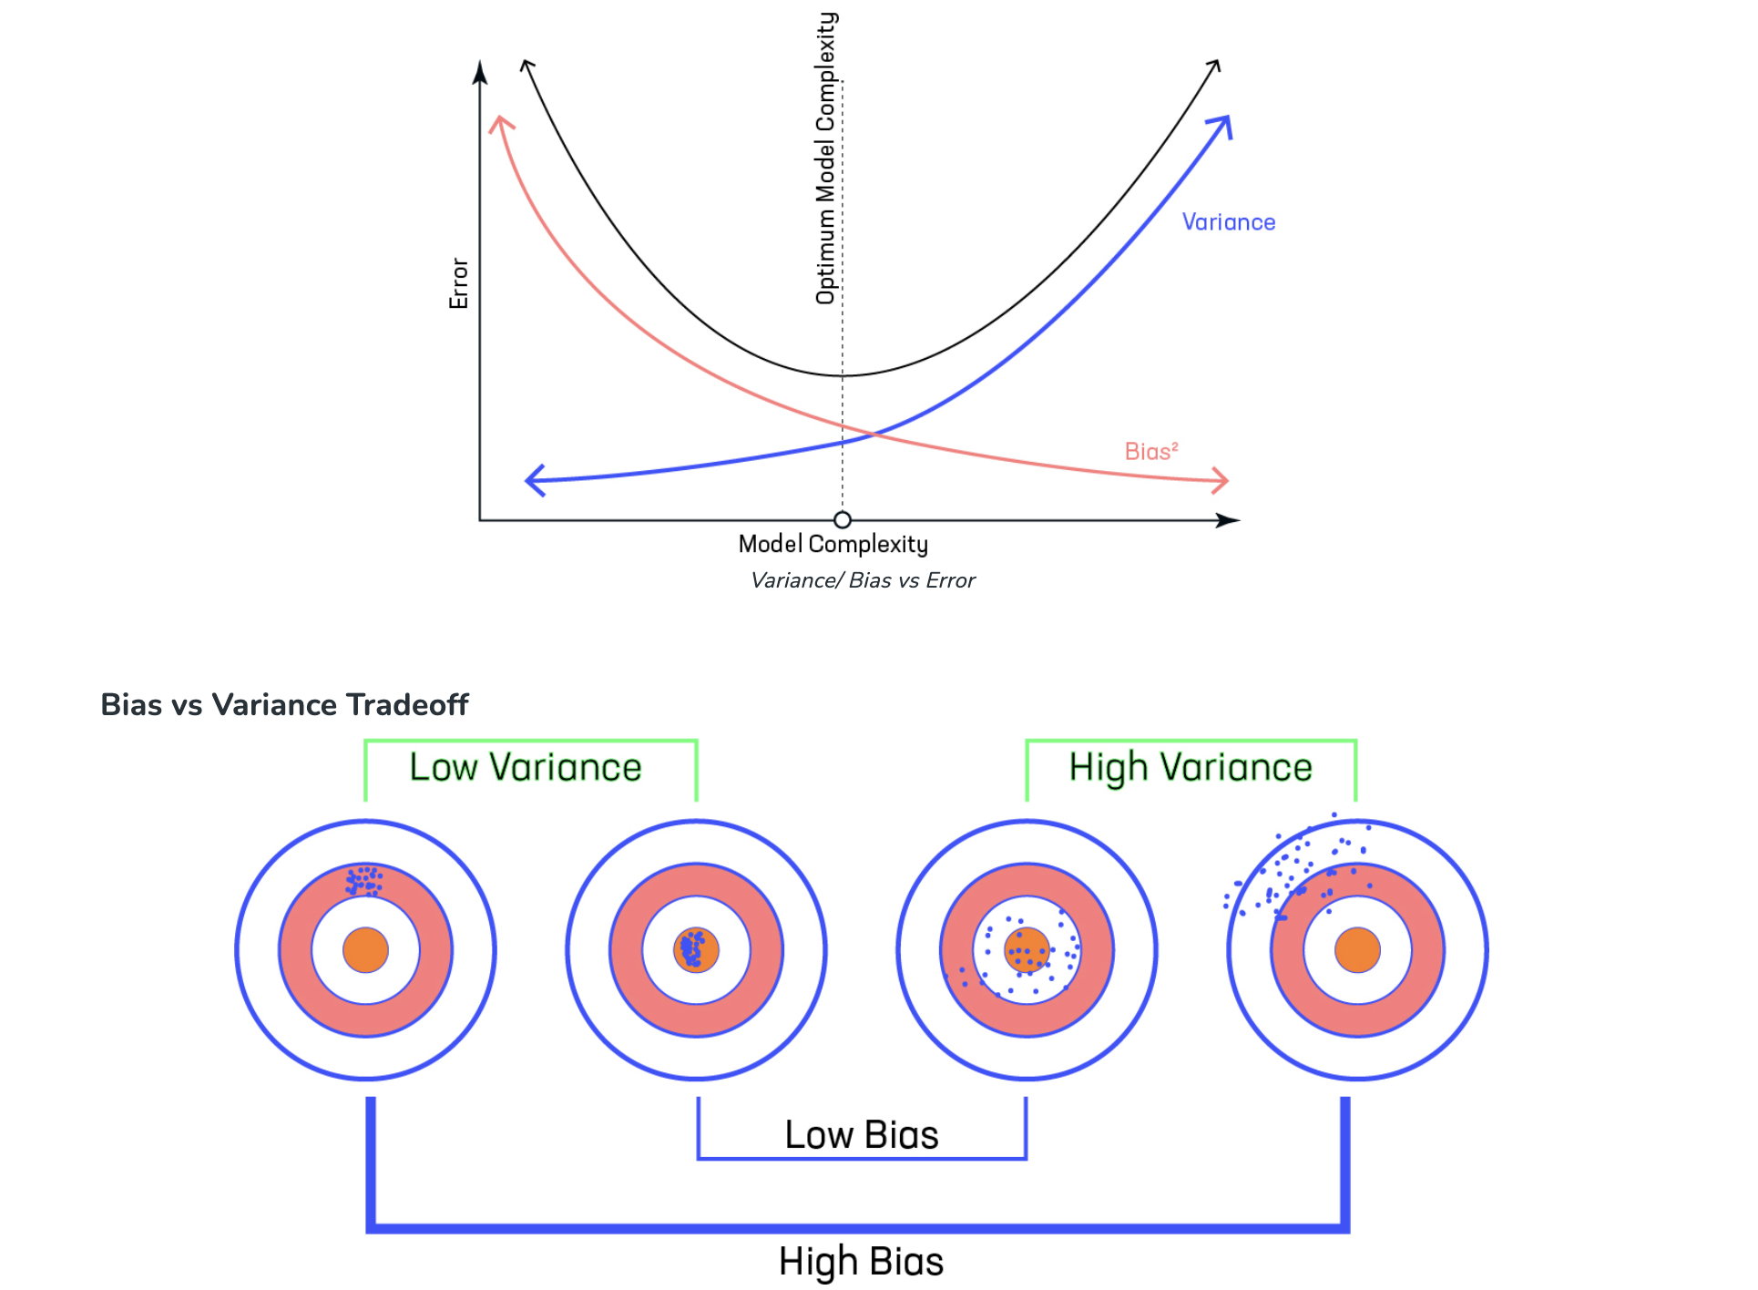

Slide 8


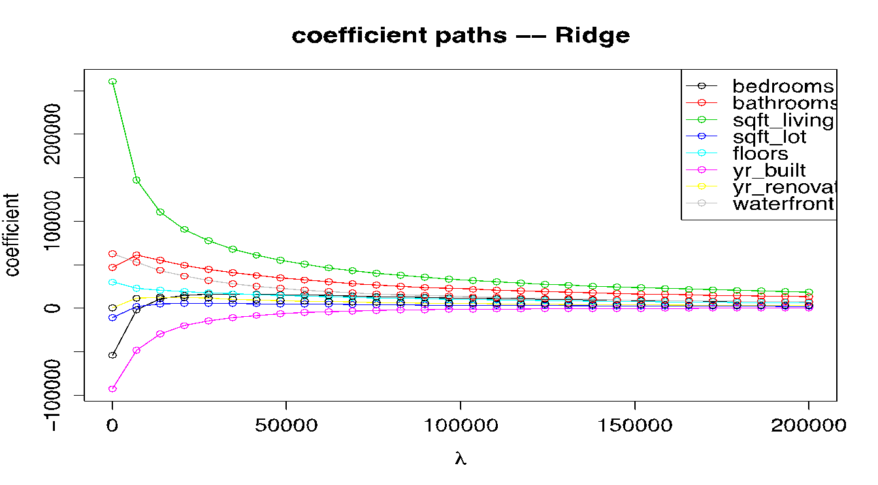
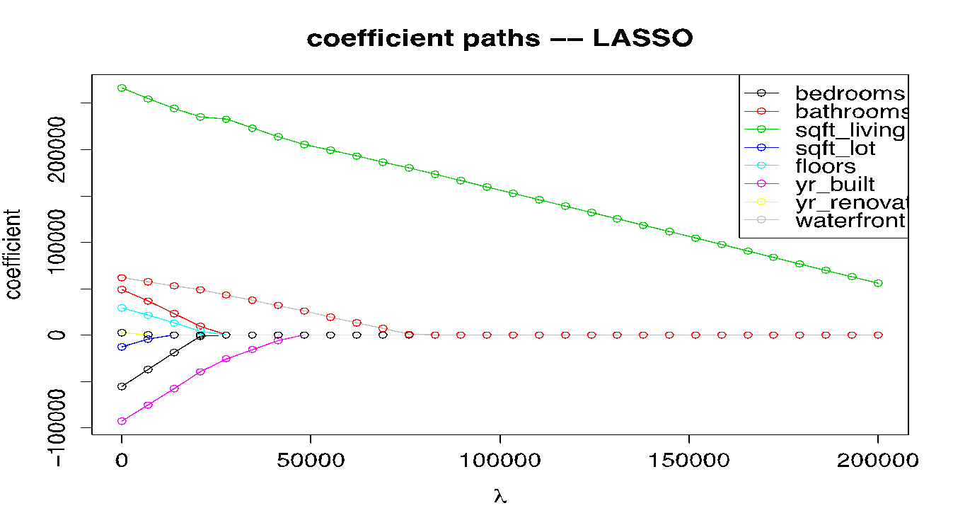
Lasso and Ridge
Ridge Coefficient Paths
2) Train with best features
Lasso Coefficient Paths
1) Feature selection

Slide 9
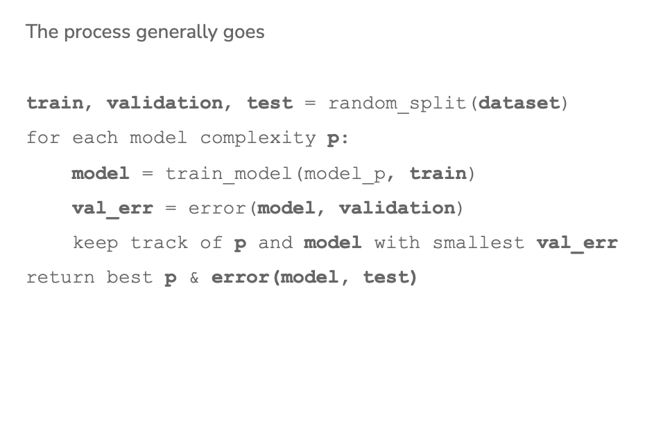
Choosing Hyperparameters
How do we choose model complexity and lambda?

Slide 10
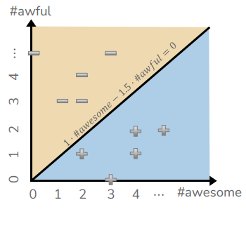

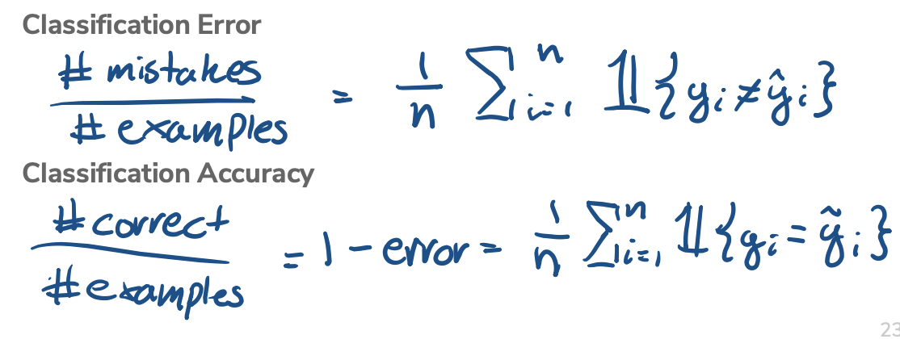
Classification
predicting discrete labels - e.g., spam detection, object detection, loan approval, etc.
decision boundary
What does Score(x) = 0 mean?
class imbalance
high classification accuracy may mean imbalanced classes

Slide 11
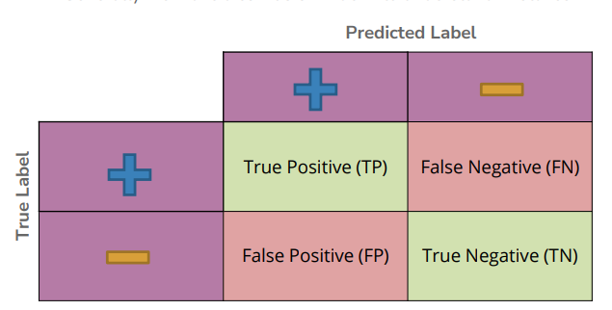
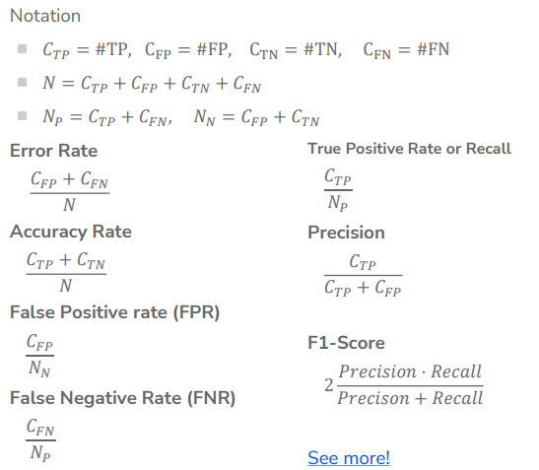
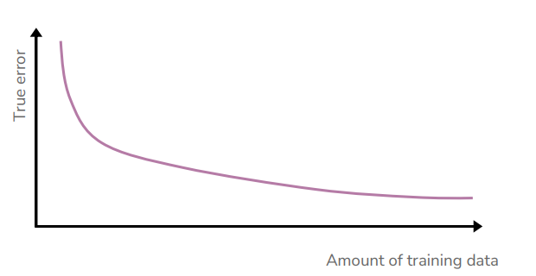
Classification 2
learning curve

Slide 12
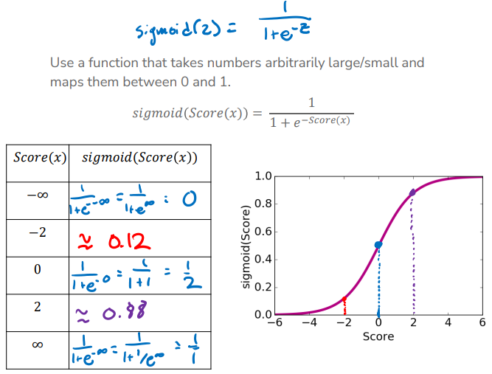
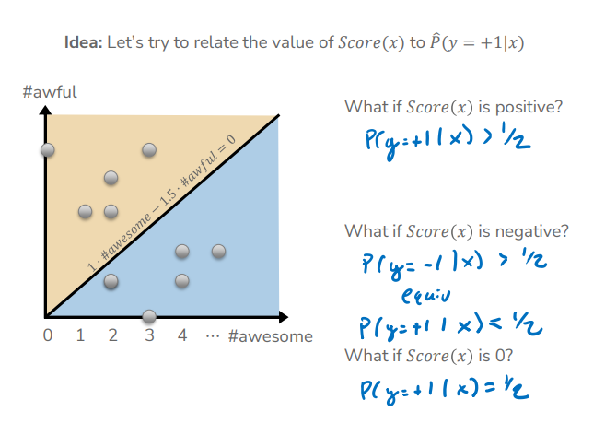
Logistic Regression
variables must be independent from each other
only two possible outcomes

Slide 13
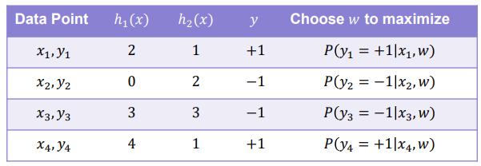
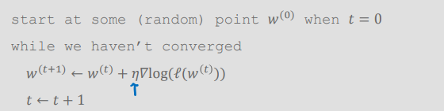
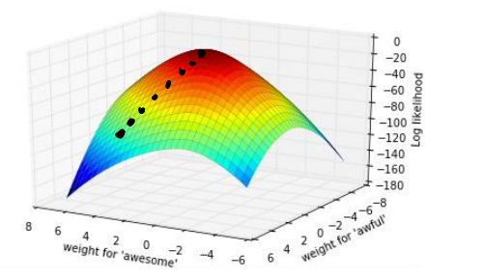
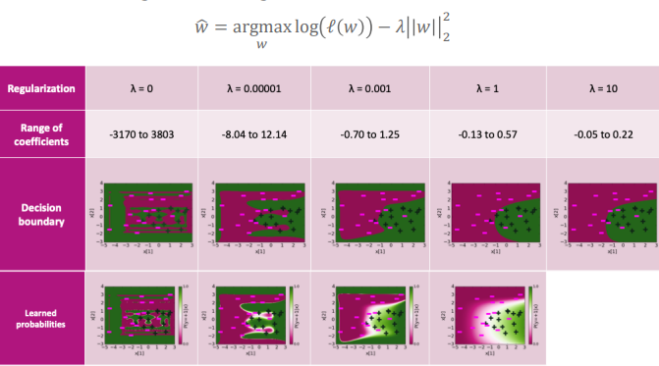
Logistic Regression 2
maximizing likelihood to find probability distribution that best explains the data
gradient ascent - going up the hill (deciding eta)
overfitting
Notes:
Reduce complexity of prediction function

Slide 14
Bias/Fairness
Sources of bias
Historical bias: world contains bias for/against certain demographics
Representation bias: training data doesn’t represent true distribution of the world
Measurement bias: using a proxy
Aggregate bias: “one size fits all” but it doesn’t
Evaluation bias: testing data doesn’t represent world well
Deployment bias: model is not used how it’s intended
Definitions of fairness
Fairness through unawareness
Statistical parity
Equal opportunity
Predictive equality
Notes:
Historical- 5% of Fortune 500 CEOs are women. Should searching “CEO” match this? Could this perpetuate more harm even though it is accurate?
Representation- ImageNet has 45% of its images taken in the US
Measurement- SAT Score -> intelligence (noisy proxy)
Aggregate- one sized all fit model- HbA1C levels across different ethnicities and sexes
Evaluation- facial recognition evaluation sets only had 5% dark skinned women
Deployment- crime risk model might not have been intended to determine prison sentence length
Fairness through unawareness- prevent the model from looking at protected attribute (remove race)
Statistical parity- each group should be represented proportionally (legal definition)
Equal opportunity- true positive rate ==
Predictive equality - true negative rate ==

Slide 15
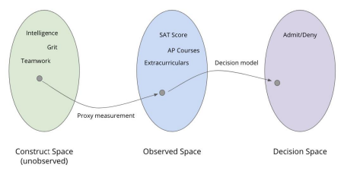
Bias/Fairness 2
What You See is What You Get (WYSIWYG):
Observed Space is a good representation of the Construct Space
comparing objects in the Observed Space as a good proxy for the Construct Space
Structural Bias + We’re All Equal (WAE):
Membership in some protected group (e.g., race) should not be the cause of a meaningful difference for the task at hand (e.g., academic preparation).
for the task at hand we are equal enough that it shouldn’t be the cause of difference
differences seen in groups in Observed Space are the result of structural bias!
Notes:
Construct space: True quantities of interest (unobserved)
Observed space: Data gathered to (hopefully) represent constructs. Achieved through measurement of proxies.
Decision space: The decisions of the model. Models take observed data and make decisions.

Slide 16
Kahoot !
https://create.kahoot.it/details/fb8ca86a-62e2-430f-8d4a-7236cfd8b8a0

Slide 17
“ML Practitioner” Practice Questions

Slide 18
Preprocessing
James’ country finance dataset has a feature called “yearly expenditures”. All of the values in the feature have differing currencies due to being from different countries. To account for this, James decides to standardize the feature. James hopes that by standardizing this column with the overall column statistics will resolve the issue of differing units.

Slide 19
Preprocessing
Incorrect. You should only use standardization when you have data points in the same units, and want to scale them to be 0 mean and 1 variance. In this case, the core problem is that the feature “yearly expenditures” has values in several different units. Karman should first convert all the values to the same units, and then he can standardize if he wants.
Note that standardization is a good strategy if different features have different units. For example, if a feature "yearly expenditures" is in "US dollars" and another feature "amount of Asian investment" is in "Singaporean dollars" then the scale of the features will be different, which will make it difficult to interpret coefficients. However, if the same feature is in different units, that is a core problem with the dataset, and you must convert that feature to use the same units across all data points.

Slide 20
Fairness (And Preprocessing)
Melissa is a data scientist at a bank and is in charge of the model that predicts whether someone will get a credit card or not. Suppose the bank wants Melissa to use ethnicity and gender information to make the decision. Notice that ethnicity and gender are categorical (or qualitative) variables. Melissa proceeds to update the model per the bank’s command and encodes (using label encoding) a number for each gender and each ethnicity.

Slide 21
Fairness (And Preprocessing)
Given that the categorical variables are nominal and not ordinal, Melissa should have used one-hot encoding instead of label encoding to convert the variables into a format that the model will understand. By using the wrong encoding approach, Melissa is enforcing a ranking/ordering between the unique values of the categorical variables where there isn’t naturally.
From the perspective of ML fairness, it is unethical for the bank to want to use gender and ethnicity as features to predict whether an individual is granted a credit card. It is wrong and not ethical of Melissa to not bring up an issue about this as using these features can perpetuate (and exacerbate) racial, gender and historical bias.

Slide 22
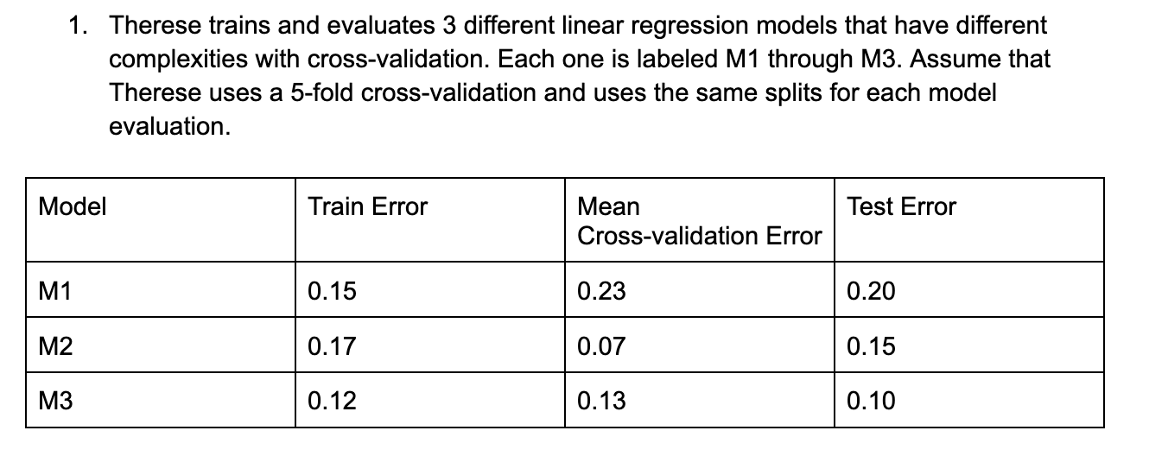
Model Selection
Therese chooses M3 as their final model because it results in the lowest train and test error among all 3 models. Why is this correct/incorrect?

Slide 23
Model Selection
Answer: Therese’s way of choosing the final model is wrong because we’ve stated before that we want to use cross-validation/a validation set to choose the model that we want to use as the final one. Choosing the final model based on train error runs the risk of the model overfitting, and choosing based on the test error means that it is no longer an unbiased estimate of the true error when the model is deployed. The model Therese should choose here is M2 because it has the lowest mean cross-validation error.

Slide 24
Bias-Variance Trade-off + Errors
After training a regression model using 100 features (columns in a dataset) and seeing a training Mean Squared Error of 1000, Lily evaluates it on a different dataset containing unseen data and gets an error of 100,000. To improve their model, they decide to add more features.

Slide 25
Bias-Variance Trade-off + Errors
Incorrect. The problem is not that the model does not have enough features, but rather that the model has overfit. To address overfitting, Lily should lower the model complexity (and one of the ways of doing so is reducing the number of features).

Slide 26
Bias-Variance Trade-off + Errors
Lily, a data scientist, is training a model to predict whether a person will drop their subscription based on the number of logins they made to the app within the week. Because their model's test error is not 0, they consider it to not be a good enough model.

Slide 27
Bias-Variance Trade-off + Errors
Incorrect. True error always contains some non-zero irreducible error. Because test error is an estimate of true error, it is unreasonable to aim for a test error of 0%. With any sufficiently large real-world dataset, it is practically impossible to get 0% test error. Lily should try to find a model that minimizes error, but it is unreasonable to find a model that has no error.

Slide 28
Regularization
Jake’s student’s performance dataset has 200 features, but they want to use fewer features in their regression model. They decide to use Ridge Regression (L2-regularization) in order to identify and select the more prominent features.

Slide 29
Regularization
Incorrect. LASSO should be used instead of Ridge for feature selection. By trying LASSO with different λ values, you can understand which features are more prominent (features whose weight stays non-zero even for higher values of λ), and which are less prominent (features whose weight gets set to 0 with lower values of λ). Ridge regression does not have this quality of zeroing out the weights for less important features.

Slide 30
Medical researchers at St. James hospital want to know how exercise and weight impact the probability of having a heart attack. To understand the relationship between the predictor variables and the probability of having a heart attack, researchers can perform logistic regression. Explain why this is correct/incorrect.

Slide 31
The response variable in the model will be heart attack and it has two potential outcomes:
A heart attack occurs.
A heart attack does not occur.
The results of the model will tell researchers exactly how changes in exercise and weight affect the probability that a given individual has a heart attack. The researchers can also use the fitted logistic regression model to predict the probability that a given individual has a heart attack, based on their weight and their time spent exercising.

Slide 32
Classification
Do we use MSE in Logistic Regression? Why and why not?

Slide 33
Classification
MSE is not used in Logistic Regression because it is not differentiable in the classification setting.

